Slide 1
FeatureCAM 2008
Product Introduction this information is preliminary. there may be additions or revisions up until the software is formally released.

Slide 2
Product Highlights
5-axis Simultaneous Machining
Major Turn/Mill Enhancements
B-axis Turn/Mill Post Development for Major Machine Manufacturers
Backplotting Capability
Automated Testing Framework
Over 101 New Features and Many Improvements
Notes:
Product highlights for Version 14:
5-axis simultaneous machining
Major Turn/Mill enhancements
B-axis Turn/Mill post development for major machine manufacturers
Backplotting Capability
Improved Feature Recognition
Automated testing framework
97 new features and many improvements

Slide 3
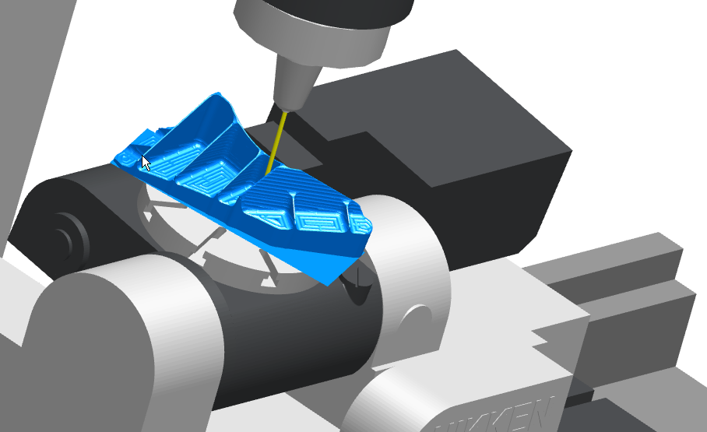
5-axis simultaneous machining

Slide 4
5-axis Simultaneous Machining
Support for 5-axis milling machines as well as turn/mill machines.
New toolpath techniques
Tool axis control
Complex 5-axis milling with FeatureCAM’s ease-of-use
Notes:
FeatureCAM Version 14 now supports 5-axis simultaneous milling that includes:
Support for 5-axis milling machines as well as turn/mill machines.
New Toolpath techniques
Tool axis control
Complex 5-axis milling with the ease of use of FeatureCAM

Slide 5
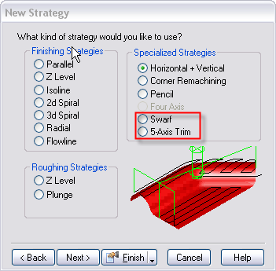
New Toolpath Techniques
5-axis Trim
Swarf
Notes:
Two additonal toolpath techniques are added:
5-axis Trim
Swarf milling

Slide 6
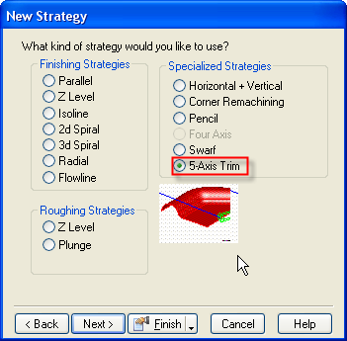
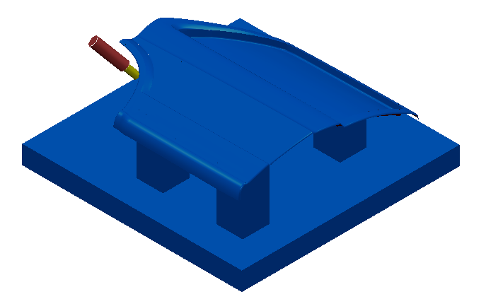
5-Axis Trim
Notes:
5-Axis Trim
This strategy is used commonly in the mold industry where cast parts have a parting line edge that needs to be removed.
Tool will cut normal to selected machining surface with lead and lean angles

Slide 7
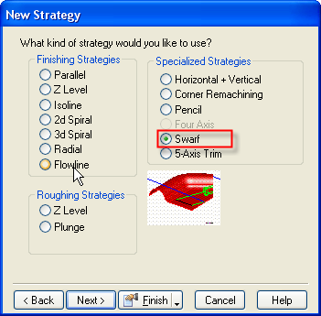
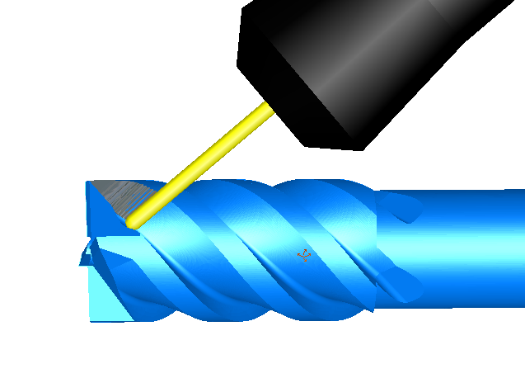
5-axis Swarf Milling
Notes:
Swarf milling:
Swarf Cutting calculates toolpaths which will cut with the side of the tool.
The surfaces selected are the side surfaces that the tool will stay tangent to
(help overview from PowerMILL below:)
Swarf Cutting is when you cut with the side of the tool and only works on developable surfaces as the tool needs to be in contact with the surface for the whole cutting depth.

Slide 8
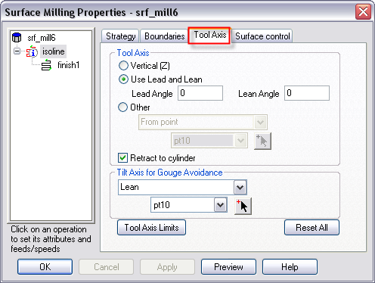
Tool Axis Control
Tool Axis Control available for:
  Parallel
  Z-level Finish
  Isoline
  3D spiral
  Flowline
  Swarf
  5-axis Trim
Notes:
Tool Axis Control:
For all of the 5-axis simultaneous supported strategies there is the ability to set tool-axis control.
The strategies supported are
Parallel
Z-level finish
Isoline
3d spiral
Flowline
Swarf
5-axis trim

Slide 9
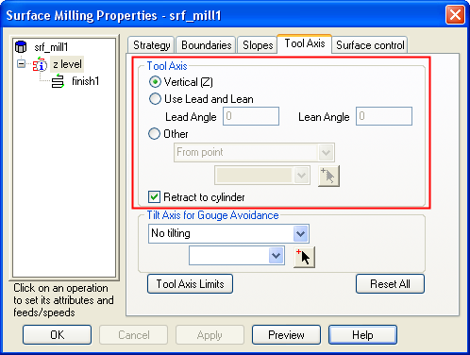
Tool Axis Control
Ability to specify simultaneous tool axis
  Vertical
  Lead/Lean
  Other
Notes:
Tool Axis Control
Vertical
Use Lead and Lean
Other
From Point
To Point
From Line
To Line
Retract to Cylinder option

Slide 10
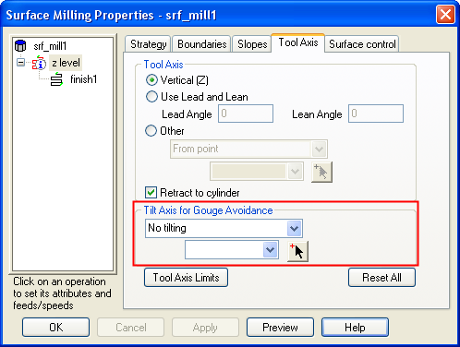
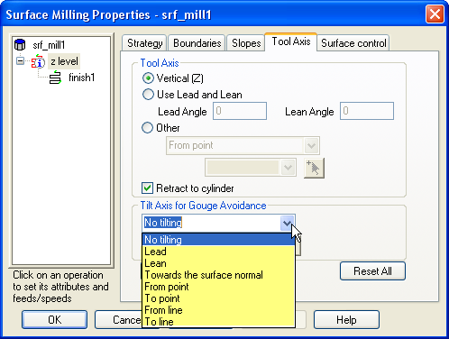
Tilt Axis for Gouge Avoidance
Strategies available to avoid gouging
  Lead
  Lean
  Towards Surface Normal
  From point/To point
  From line/To line
Notes:
Tilt Axis for Gouge Avoidance
No Tilting
Lead
Lean
Towards the surface normal
From point
To point
From line
To line

Slide 11
5-Axis Ease of Use
Straightforward user interface:
  Simplified
  Consistent with other modules
Focus on automation and quick toolpath creation, leaving detailed control and high-end tool/die to PM
Notes:
Straightforward user interface:
Simplified
Consistant with other modules
Focus on automation and quick toolpath creation, leaving detailed control and high-end tool/die to PM

Slide 12
Turn/Mill Improvements
Pattern creation now more intuitive
Z-face rotation for machines with limited Y movement
Mill simple groove with a 3d curve at any index angle
More example files, *.md files and posts
Many improvements based on customer feedback and requirements
Notes:
Turn/Mill Improvements
Pattern creation now more intuitive A-019845 (Gives a preview and creates a pattern in place, easier to create radial pattern)
Z-face rotation for machines with limited y movement A-022609
Mill simple groove with a 3d curve at any index angle A-017946
Many small improvements
More example files, *.md files and posts

Slide 13
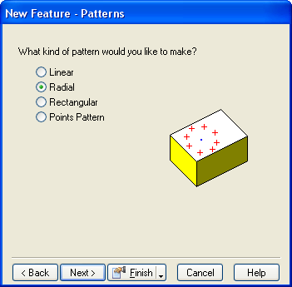
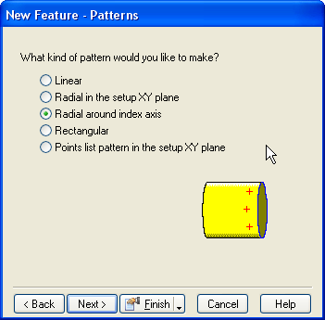

Improved Pattern Creation
New option for radial patterns
V13
V14
Notes:
Pattern creation interface more intuitive (A-019845)
New Previews shown
Pattern can be anywhere along the stock

Slide 14
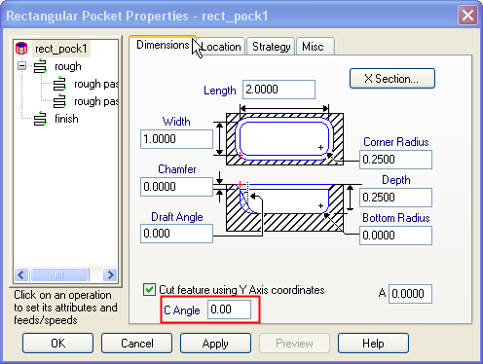
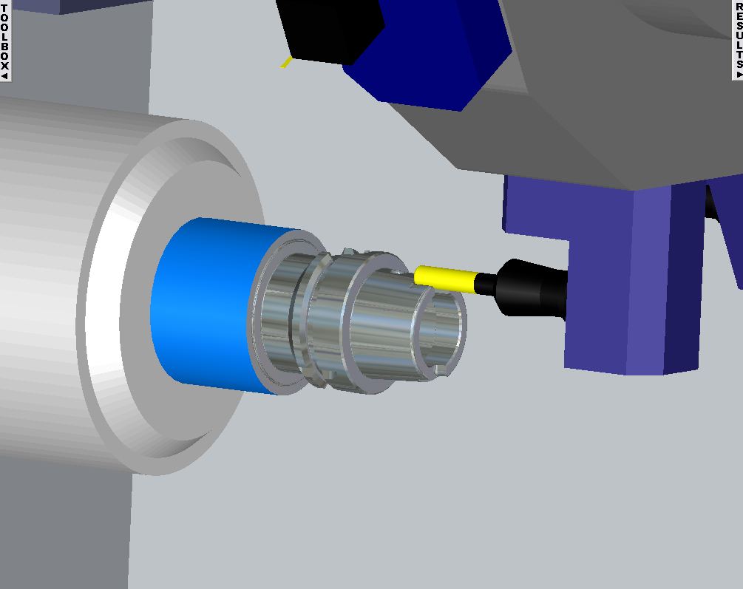
Z-Face Rotation for Machines with Limited Y Movement
Notes:
For machines with limited Y movement get to specify the c angle where y moves are performed A-022609

Slide 15
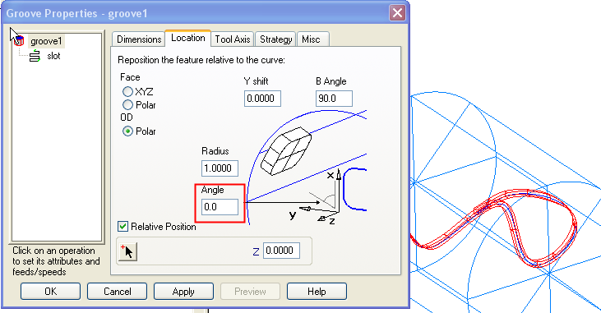
3D Groove at any Index Angle
Notes:
We now have the ability to create a 3D Groove at any index angle. A-017946

Slide 16
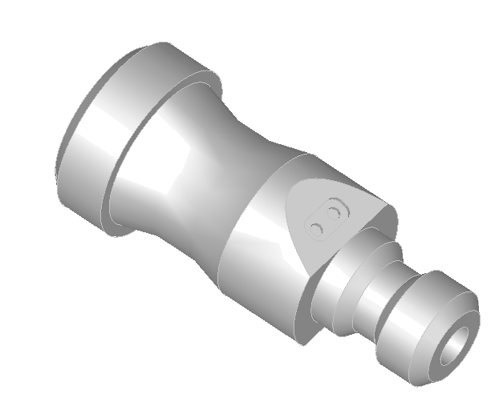
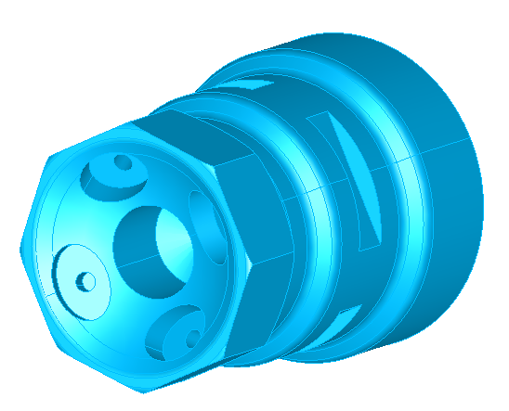
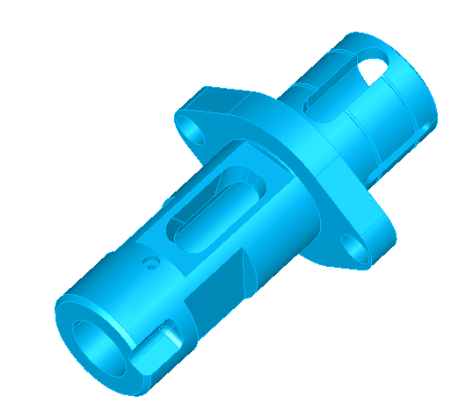
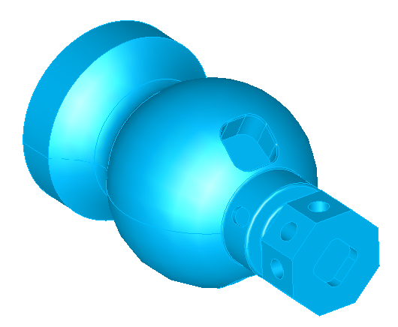
More Example Files
Notes:
We now have more example/demo files for Turn/Mill
Listed clockwise upper corner first:
rounded face with pockets baxis.x_t
Turn profile and b milling.x_t
Hourglass.x_t
pin with baxis pocket.x_t

Slide 17
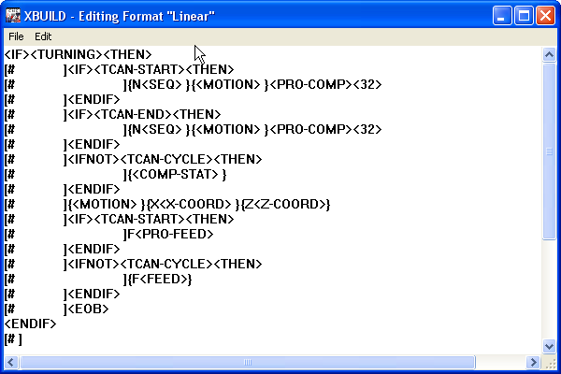
New Turn/Mill Posts
Posts from major manufacturers:
  Hardinge Quest Single and Multi Turret
  Mazak Integrex-IVS
  DMG CTX
  Mori Seiki NT Series
  Nakamura
Notes:
Posts from major manufacturers:
Hardinge Qwest Single and Multi Turret
Nakamura WT300
Mazak Integrex-IVS
DMG CTX400
Mori Seiki NT 4250

Slide 18
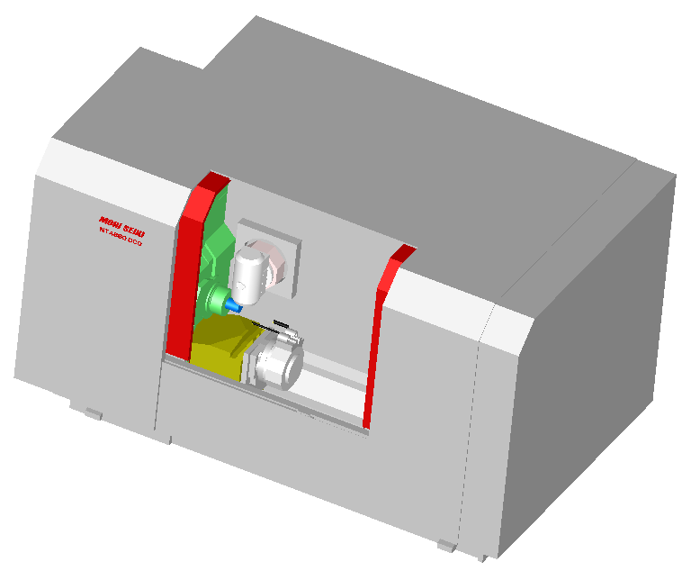
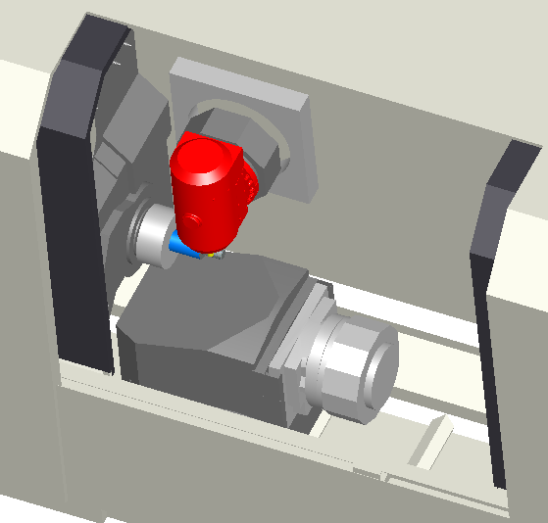
New Machine Design Files
Notes:
More example files, *.md files. Find machine design examples in \examples\machine design\contrib
Mori seiki nt 4250
Nakamura wt-300
Daewoo puma mx4000
Improved Mazak Integrex

Slide 19
Turning Enhancements
Drilling canned cycles
Closed curve as stock curve
Using solid defined as stock to calculate boundary
AFR interface improvements (Run AFR anytime, make more like milling interface)
Skip wall pass (tight bore)
More thread types
Multiple setups – one program
Notes:
Turning Enhancements
Drilling canned cycles A-007999
Closed curve as stock curve A-020058
Using solid defined as stock to calculate boundary A-014752
AFR interface improvements(Run AFR anytime, make more like milling interface) A-019828
Skip wall pass (tight bore) A-022303
More thread types A-017330
Multiple setups – one program A-014583

Slide 20
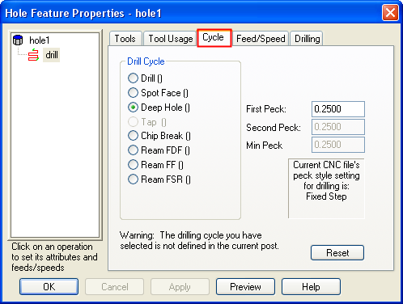
Drilling Canned Cycles
Canned cycle support
  Drill
  Spot Face
  Deep Hole
  Chip Break
  Ream
Notes:
We now support drilling canned cycles (not available in V13) A-007999

Slide 21
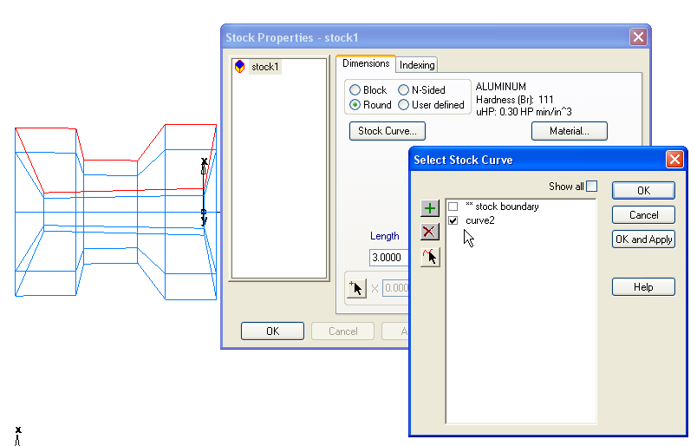
Closed Curve as a Stock Curve
Notes:
Closed Curve as a Stock Curve A-020058

Slide 22
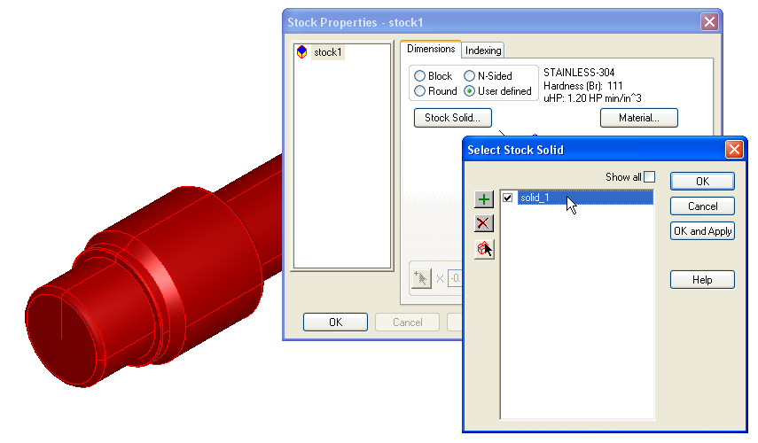
Turning – Solid as Stock
Notes:
Boundary now created correctly by setting solid as stock! A-014752

Slide 23
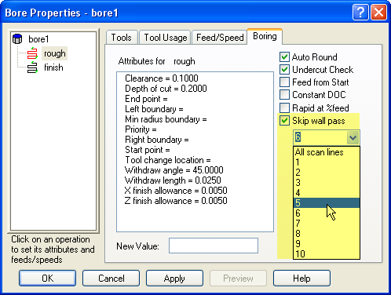
Skip Wall Pass
Ability to skip number of scan lines
Notes:
Have the ability to skip wall pass for tight bores. Have the ability to specify the number of scan lines skipped A-022303

Slide 24
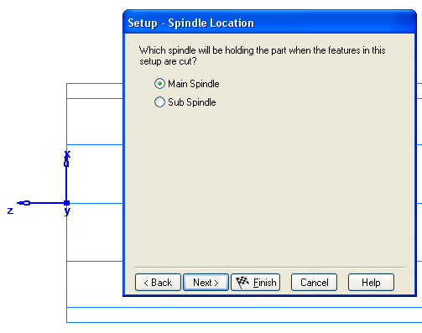
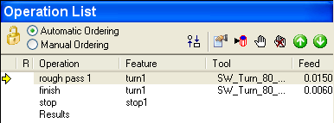
Multiple Setups – One Program
Stop automatically inserted
Notes:
Automatically insert a stop if second setup is on the backface of stock using main spindle A-014583

Slide 25
3-axis Milling
New operation – between two curves
New operation – swarf milling for 3-axis machining
New operation – parallel roughing – restored from V12
Improved boundaries
  Improved, easy-to-use UI (better organized, previewing)
  Improved internal only (accuracy, depth options)
  New selected surface boundary
Faster toolpath computation
New plunge/retract options for plunge off-part
New horizontal plunge clearance for undercut handling
Notes:
3-axis milling
Between 2 curves –
Swarf milling –
New separate parallel roughing operation
Improved boundaries
Combined boundary tab – visualize boundary: Gives user the ability to visualize the combined boundary
Improved accuracy of "internal only" boundary.(new method) – a new algorithm is used that looks at surfaces in a different way
New options for "top" or "bottom" of vertical walls with "internal only".
Minimum 15% increase (Tim said this)
Performace increases (improved algorithm)
New plunge/retract options for undercutting (new option gives linear distance that extends surfaces)

Slide 26
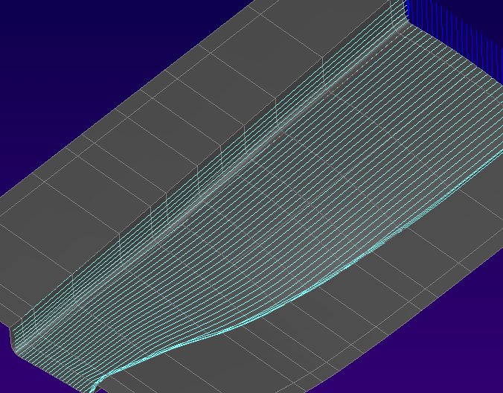
New Operation - Between Two Curves
A morphed toolpath between two curves
Morphed toolpath means no sharp corners (good for high speed)
Notes:
to mill an outside fillet made up of multiple surfaces. A morphing operation, so it is kind of a way to do multiple surface isolines by tracing a couple of boundaries and milling between the two. You use surface edges tool to extract the boundaries. It handles two open curves. And it morphs. It is different from spiral 3d in that spiral 3d requires closed curves. And spiral 3d uses offsets instead of morphs. Because we are morphing, you won’t get any sharp corners, so it is good for high speed machining.

Slide 27
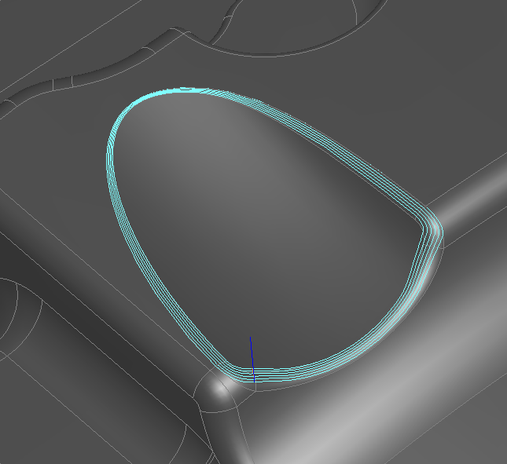
New Operation - Between Two Curves
Good for outside fillet on multiple surfaces
Think of it like a multi-surface isoline
Supports open curves (Spiral 3D requires closed curves)
Supports 3D stepover like Spiral 3D
Notes:
to mill an outside fillet made up of multiple surfaces. A morphing operation, so it is kind of a way to do multiple surface isolines by tracing a couple of boundaries and milling between the two. You use surface edges tool to extract the boundaries. It handles two open curves. And it morphs. It is different from spiral 3d in that spiral 3d requires closed curves. And spiral 3d uses offsets instead of morphs. Because we are morphing, you won’t get any sharp corners, so it is good for high speed machining.

Slide 28
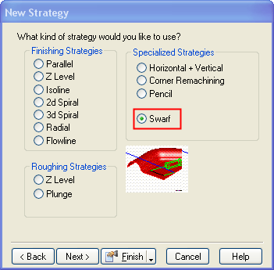
New Operation - 3-axis Swarf
Swarf milling for 3-axis
  Select vertical (or nearly) side surfaces
  Tool constrained to be vertical, but touching side surfaces
Best & easiest way to cut vertical wall
Other methods (z-level, pencil, isoline) have various limitations
Notes:
Swarf milling for 3-axis:
Swarf Cutting calculates toolpaths which will cut with the side of the tool.
The surfaces selected are the side surfaces that the tool will stay tangent to
Benefits: it is the best way to cut a vertical wall as a single pass or in steps. It is a more robust way than our other methods.
Here are the issues we have with other approaches: If you have multiple surfaces and you can’t do it with isoline, then you can try cut with z-level finish, but sometimes a lot of work to get the right boundary and get it to stop at the bottom. You can cut sometimes with pencil milling if you have something at the bottom that fits. But with a swarf you can cut the surfaces all the time, whereas with this other routines there are some gotchas. A common problem is when you have horizontal surface on the top. If the horiz surface is a check surface, then z-level finish might retract and make a mess. Swarf won’t have this problem.
If the surfaces aren’t exactly vertical, it still works.

Slide 29
New Operation – Parallel Roughing
Genuine parallel roughing, not the Z-level substitute offered by V13
Restored from V12
Will utilize Delcam 3-axis toolpath code
Demanded by existing users

Slide 30
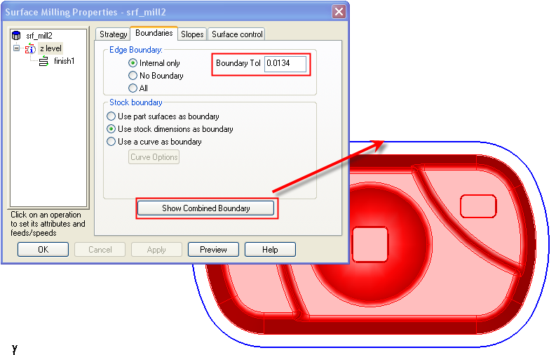
Boundaries - Ability to Preview
Notes:
Combined Boundary Tab
Shows combined boundary curve
Able to adjust boundary tolerance- Improved accuracy of "internal only" boundary.

Slide 31
Boundaries - Improved “internal only”
Improved accuracy of "internal only" boundary
New options for "top" or "bottom" of vertical walls with "internal only"
Notes:
Improved internal only boundary
Improved accuracy of "internal only" boundary.(new method) – looks at surfaces in a different way
New options for "top" or "bottom" of vertical walls with "internal only"

Slide 32
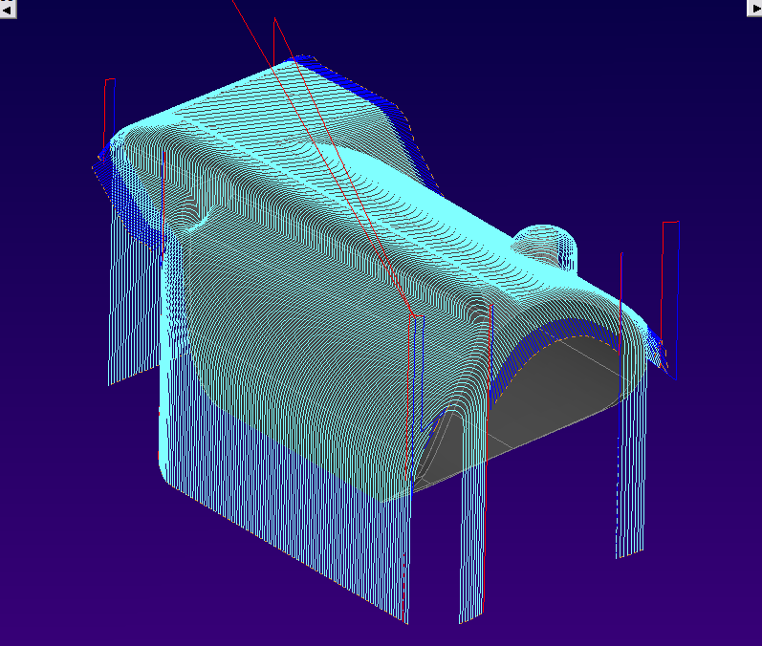
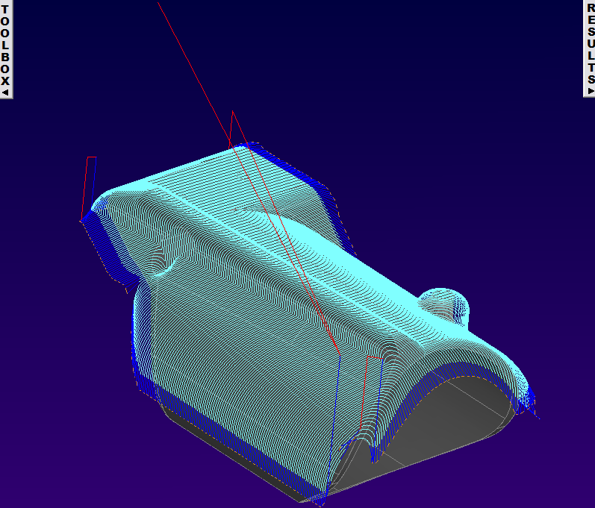
Boundaries - Internal Only Improvements
Improved accuracy of "internal only" boundary
V13
V14
Notes:
V13 was done with a less accurate boundary that causes the toolpath to drop all the way to the bottom of the stock. V14 improves upon this.

Slide 33
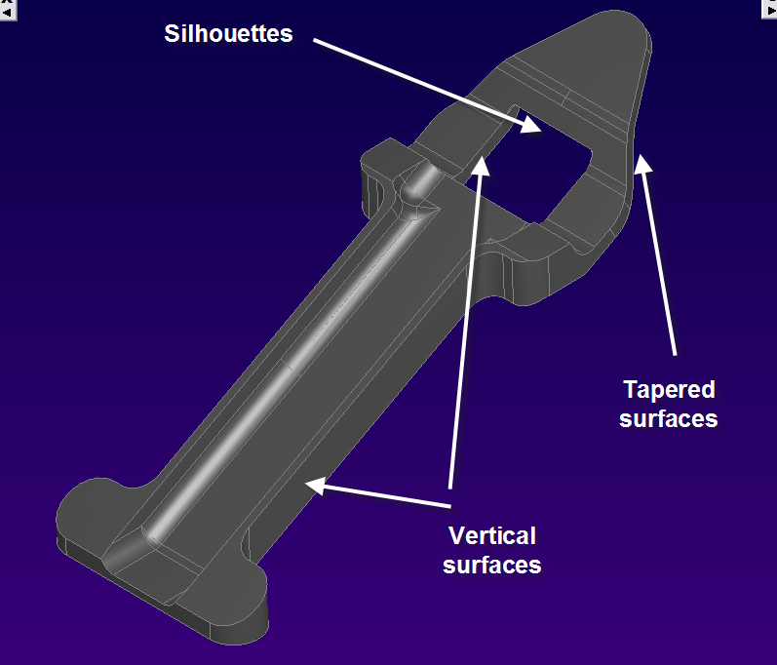
Boundaries - Internal Only Improvements
Part properties for internal only example
Notes:
Part properties for internal only example

Slide 34
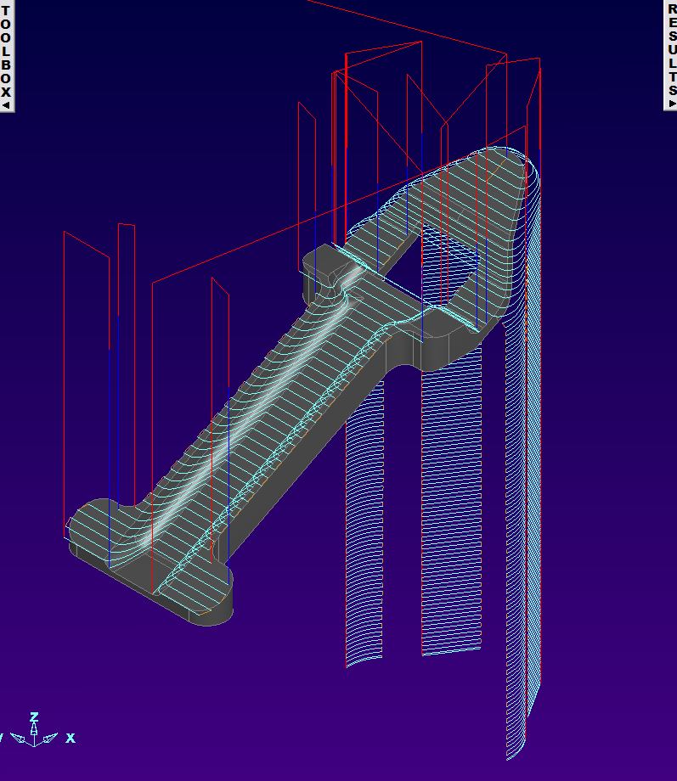
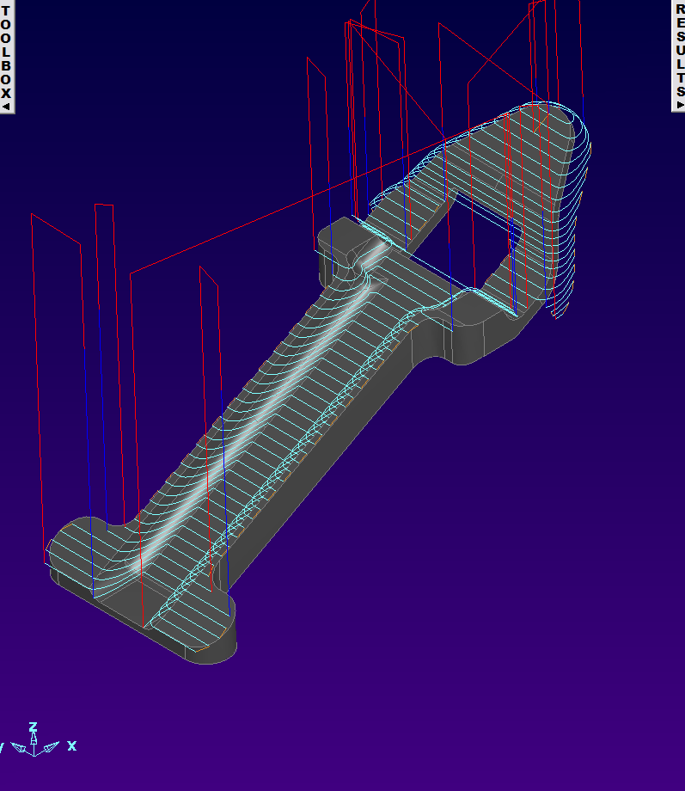
Boundaries - Internal Only “Top"
V13
V14 – Top Surface
Notes:
V14 has two options "top" or "bottom" (include the vertical walls).

Slide 35
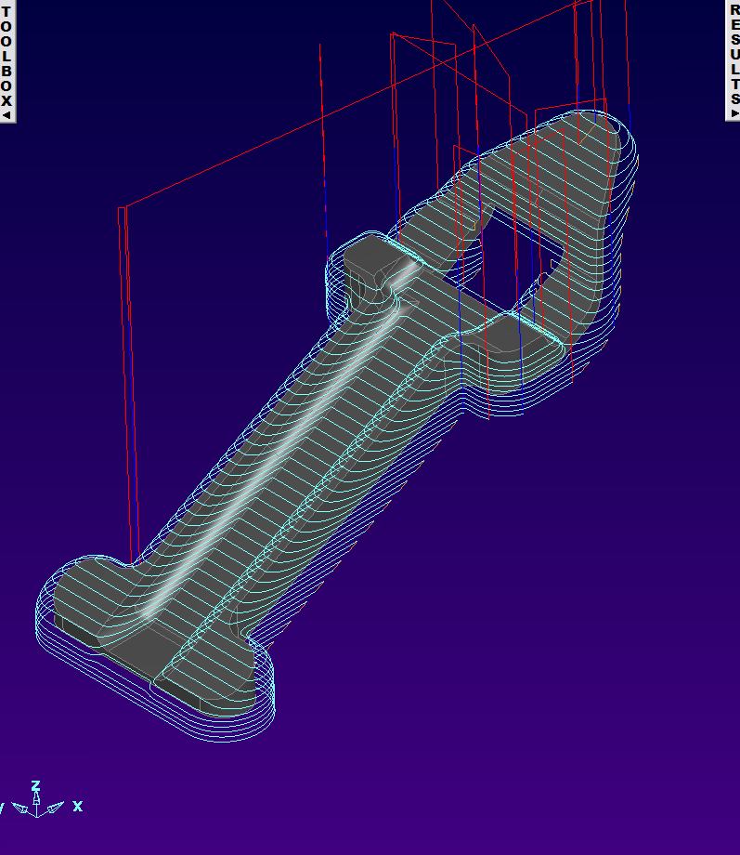
Boundaries - Internal Only “Bottom"
V13
V14 – Bottom Surface
Notes:
V14 has two options "top" or "bottom" (include the vertical walls).

Slide 36
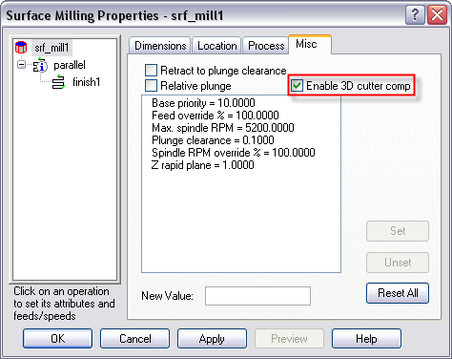
3D cutter comp support
3D cutter comp available for supported Machines
Notes:
We now have 3D cutter comp support

Slide 37
2.5D Enhancements
Ability to post subprogram common to all z depths
Custom thread database
Support for left handed tapping and milling tools
Notes:
2.5D enhancements
Ability to post subprogram common to all z depths A-020728
Custom thread database (API on Addins page)
Support for left handed tapping and milling tools (A-003958)

Slide 38
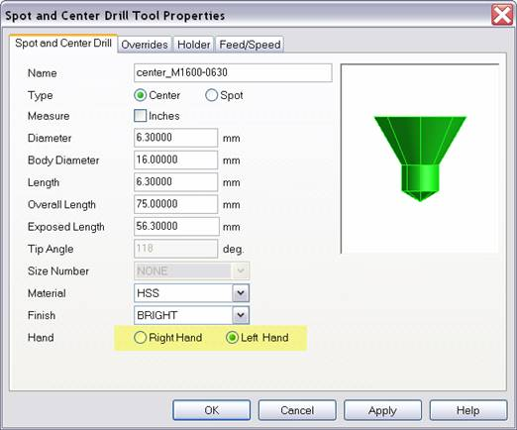
Left-Handed Operation Support
Support for Left Handed Tapping and Milling
Any Tool!
Notes:
Support for Left Handed Tapping and Milling
Any Tool!

Slide 39
Tooling Improvements
Specify what type of operation is used for in tool properties
Ability to specify coolant type per tool
Metric and English lollipop cutters added to tooling database
Specify feed and speed per tool
Notes:
Tooling Improvements
Specify what type of operation is used for in tool properties A-010685
Ability to specify coolant type per tool A-012307
Metric and English lollipop cutters added to tooling database
Specify feed and speed per tool

Slide 40
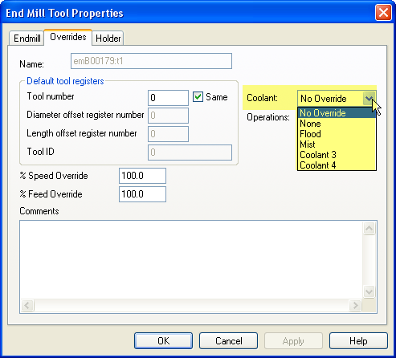
Coolant Type Per Tool
Coolant types available in tool properties
  Flood
  Mist
  Coolant3
  Coolant4
Notes:
Coolant type per tool A-012307

Slide 41
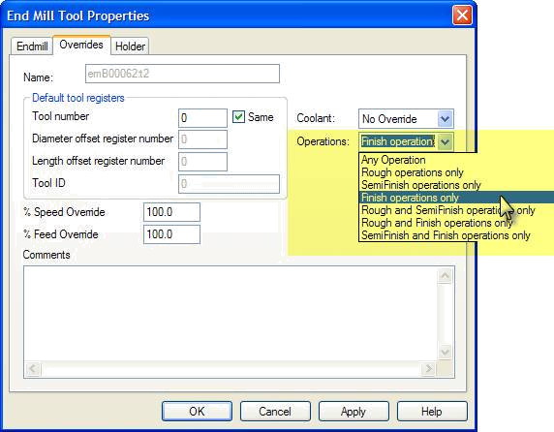
Specify Operation Type Per Tool
Operation type specified in tool properties
  Rough or
  Finish
  Rough and
  Finish
  Rough and
  SemiFinish
  Ream…etc.
Notes:
Operation Type per tool A-010685

Slide 42
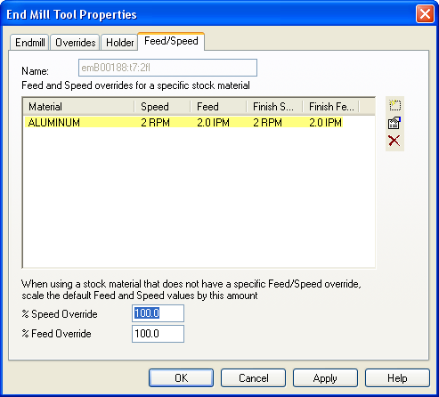
Specify F/S per tool
F/S specified in tool properties
  Profile cuts
  Slotting cuts
Notes:
F/S per tool A-005134

Slide 43
4th Axis
True 4-axis simultaneous
  Produce pocket walls parallel or normal to a surface
(5-axis simultaneous required for this)
Notes:
4th axis
Produce pocket walls parallel or normal to a surface A-007317
(Result of having simultaneous toolpaths - 5-axis simultaneous required for this)

Slide 44
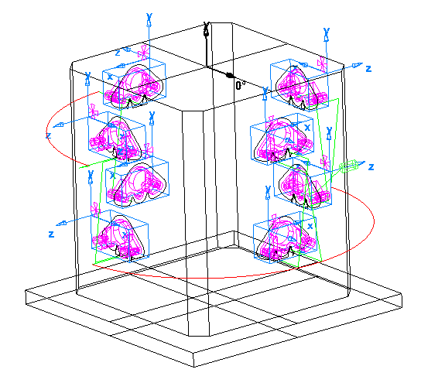
Tombstone
Shorten distance between indexing
Notes:
Tombstone
Shorten distance between indexing A-019308
A more optimized toolpath is taken(works better)

Slide 45
Wire EDM
4-axis strategy support
Macro support
New 2-axis taper strategies
  Rounded
  ISO/Rounded
Notes:
Wire EDM
4-axis strategy support A-021004
Macro support A-023394
New 2-axis taper strategies (unscheduled project?)
Rounded
ISO/Rounded

Slide 46
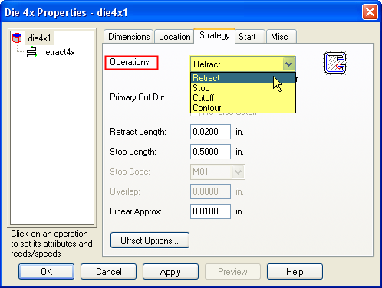
Wire 4-Axis Support
New 4-Axis strategy support
  Retract
  Stop
  Cutoff
  Contour
Notes:
We now have Retract, Stop, Cutoff and Contour strategies supported for 4-axis in wire A-021004

Slide 47
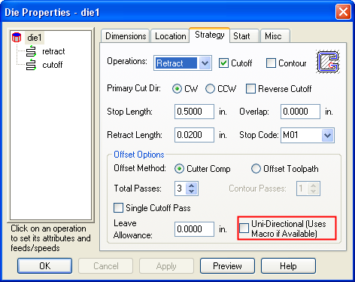
Wire Macro Support
New macro support
Notes:
New Macro support A-023394

Slide 48
Feature Recognition
Interactive FR improvements for turn/mill and milling
Wire EDM FR for any type of surface
5-axis positioning hole recognition
Notes:
Feature Recognition
Interactive FR improvements for turn/mill and milling
Wire EDM FR for any type of surface
hole recognition from multiple angles is now supported by our 5-axis positioning product

Slide 49
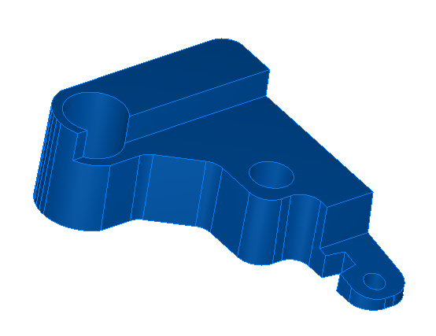
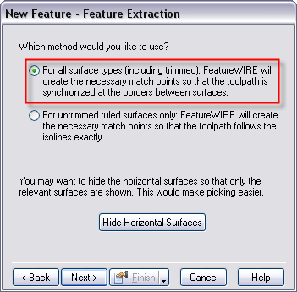
Feature Recognition
Wire EDM FR for any type of surface
This sample part along with a tutorial is available in our training materials on the distributor site
Notes:
Feature Recognition with Wire:
We now support wire Feature Recognition on any type of surface
This new tutorial may be downloaded from our distributors site

Slide 50
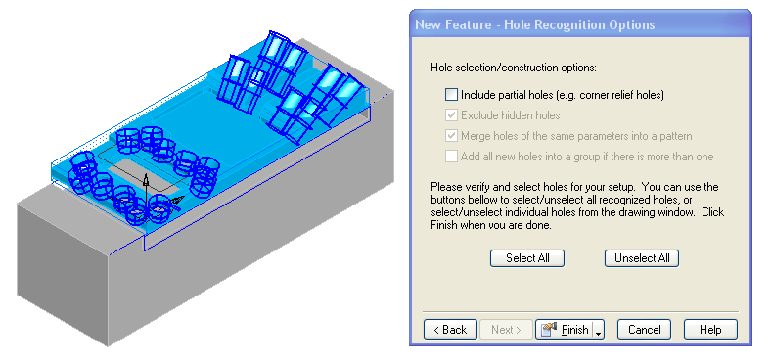
5-axis Hole FR
Feature Recognition for holes at any index angle

Slide 51
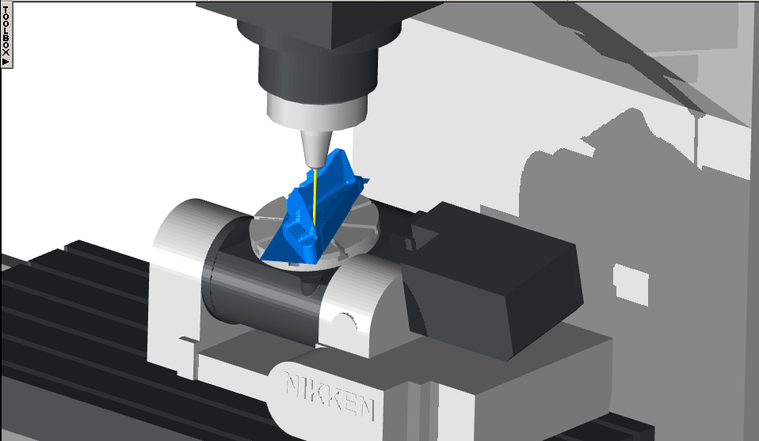
New Improved Simulation
Notes:
New Improved Simulation
Machine simulation faster and appear more realistic …circular solids/surfaces not faceted
Increased Performance using hardware acceleration
5-axis simultaneous gouge detection
Select holder color

Slide 52

Machine Sim .dmt Support
Notes:
Have the ability to use machine models in .dmt format

Slide 53
Improved Import Capabilities
MasterCAM turning tool crib import
STL import (use stl as stock)
SolidEdge .psm import
We keep up-to-date on all of our file formats
Notes:
Import
MasterCAM tool crib import A-022641
STL import (use stl as stock) A-001281
SolidEdge .psm import A-022546
We keep up-to-date on all of our file formats

Slide 54
API
Many API enhancements from users
More API access
An API help file that is generated automatically for each build of FeatureCAM

Slide 55
Easier Post Creation
Many new reserved words that simplify post creation
Support for brake/clamp operations
Fewer mouse clicks
Collection of more unique posts onto CDROM
New standard number of post variables
Sync codes
New subspindle features
Many Turn/Mill improvements
Show version info in Internet explorer
Notes:
Easier post creation
Many new reserved words that simplify post creation
Support for brake/clamp operations
Fewer mouse clicks
Collection of more unique posts onto CDROM
New standard number of post variables
Sync codes
New subspindle features
Many Turn/Mill improvements
Show version info in Internet explorer A-022845

Slide 56


5-axis machine Support in Xbuild
Notes:
New 5-axis machines supported in Xbuild
C rotary table and 45 deg. Angled B tilting head – rotate about Z, then angled Y
C rotory table and 45 deg. Angled A tiltiling head – rotate about Z, then the angled X

Slide 57
Documentation
Now we ship our posts with a documentation file refecting on how to use the post and supported functions
Turn/Mill posts are now located in a separate folder

Slide 58
Distributed Automated Testing
Testing helps to find software failures, identify the correctness and quality of the software
We have developed our own automated testing framework/environment
600+ tests run nightly
Uses example files that tests features, attributes, final NC code and more…
Notes:
Distributed Automated Testing
Testing helps to find software failures, identify the correctness and quality of the software
We have developed our own automated testing framework/environment
600+ tests run nightly
Uses example files that tests features, attributes, final NC code and more

Slide 59
General Enhancements
Windows Vista compatibility
Expanded help with links to help files in other languages
New FeatureCAM forum

Slide 60
Expanded Support
Increased support capacity
  Support now in opposing time zones
  Less turn around time for support issues

Slide 61
Proactive Post Development
3 person team working posts fulltime
Work with machine manufacturers to create factory certified post

Slide 62
Coming Soon…
New selected surface boundary
New "between two curves" morphing finishing operation
New plunge options for Z roughing
New boundary options for Z roughing
Parallel Roughing Strategy
New plunge/retract options for undercutting
Ability to specify index angle for IFR by selecting horizontal surface
ability to use Delcam machines in featurecam’s machine sim.
Notes:
New selected surface boundary
New "between two curves" morphing finishing operation
New plunge options for Z roughing
New boundary options for Z roughing
Parallel Roughing Strategy
New plunge/retract options for undercutting
Ability to specify index angle for IFR by selecting horizontal surface
ability to use Powermill’s machines in featurecam’s machine sim. ability to use Delcam machines in featurecam’s machine sim.

Slide 63
Future Work
Turn/Mill ongoing (machine designs, posts, ease-of-use)
SolidWorks gold partner
Wire EDM improvements
Notes:
Future Work
Turn/Mill ongoing (machine designs, posts, ease-of-use)
SolidWorks gold partner
Wire EDM improvements

